Slide 1
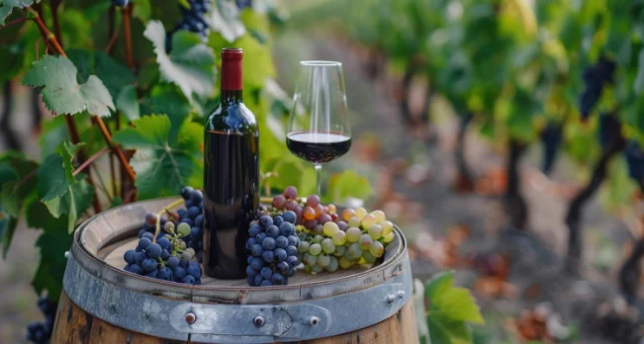
An Analysis on Wine Quality
Katherine Nguyen
Isiah Perine
-
DS 6306 Doing Data Science
Notes:
Hello! My name is Katherine and my partner is Isiah, and today we will be analyzing the extent of which features affect wine quality.

Slide 2
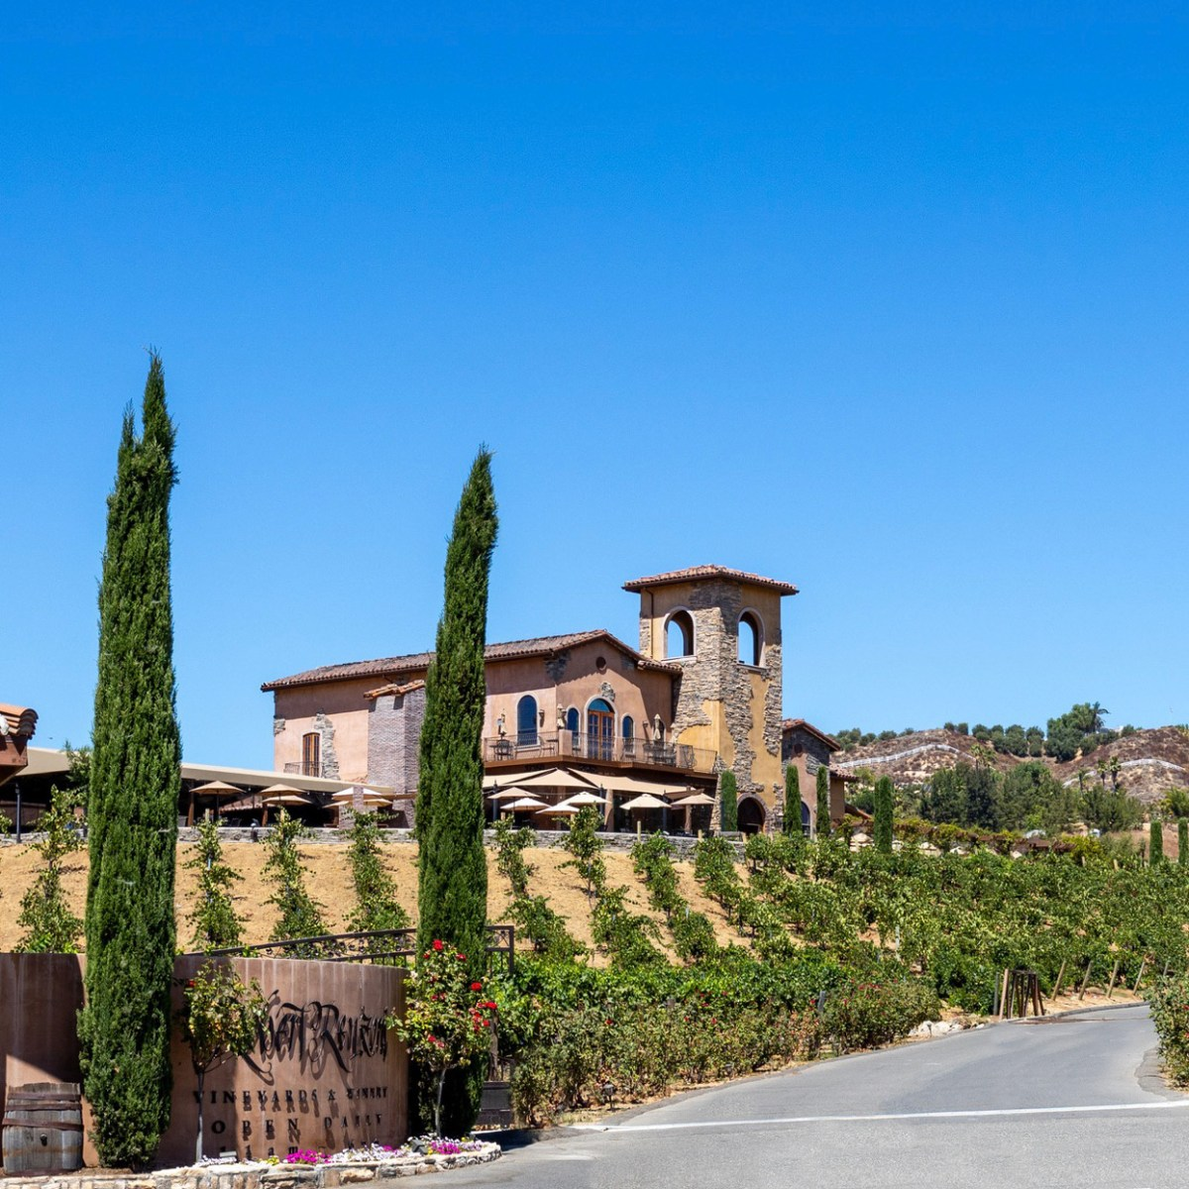

OVERVIEW
AUDIENCE:
GOALS:
Identify top factors contributing to high-quality wine
Introduce a model based on top factors to optimize wine quality prediction
Inform ideal production processes to produce superior wines
Head Vintner: Olivia Bue
Notes:
This topic was brought to us by the head vintner at Robert Renzoni Vineyards with the hopes of identify top factors that contribute to high quality wine and to curate a model that would predict wine quality and optimize production processes, to of course, produce the highest quality of wines.

Slide 3
DATA OVERVIEW
FACTORS:
Based on physicochemical tests
OUTPUT:
Sensory data based on median of 3+ wine expert evaluations
Fixed Acidity
Volatile Acidity
pH
Residual Sugar
Alcohol
Free Sulfur Dioxide
Total Sulfur Dioxide
Density
Chlorides
Citric Acid
Sulphates
Type
Location
Quality
score from 0 (worst) to 10 (best)
Notes:
The features of interest that were provided are:
Acidity Levels: Both fixed and volatile acidity could influence the taste and preservation of wine.
pH Level: The pH of wine can impact its color, stability, and overall balance.
Sugar Content: Residual sugar levels may affect the sweetness and fermentation process.
Alcohol Content: Higher alcohol levels might correlate with perceived wine quality.
Some other features considered are listed here. Again, our goal is to predict quality on a scale of 0 to 10, which the original data set provided as the median of wine expert evaluations. Now, I will pass the mic to Isiah to discuss how we landed on our 5 top factors.

Slide 4
DATA PROCESSING
Clean up data by removing or replacing missing data
Visualize and quantify correlations with “quality”
Identify top features
Explore various models to best predict “quality”
Notes:
First step was to clean the data. In order to accomplish this, we removed missing data or replaced missing data with the average within that category. Thankfully, the training set did not have any missing data to address. Then, we visualized and obtained correlation values for each feature, which became the main metric in identifying top features. Using the top 5 features found, various models were formulated and compared to best predict quality.

Slide 5
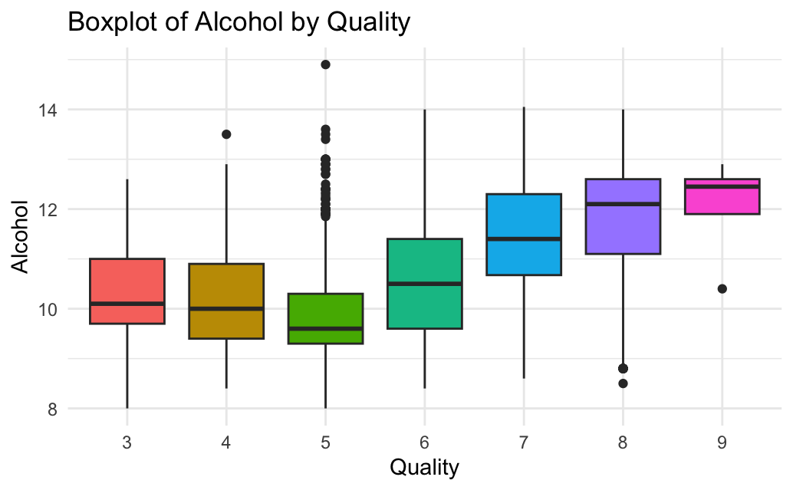
Alcohol vs Quality
Note: Higher levels of quality associated with higher values of alcohol

Slide 6
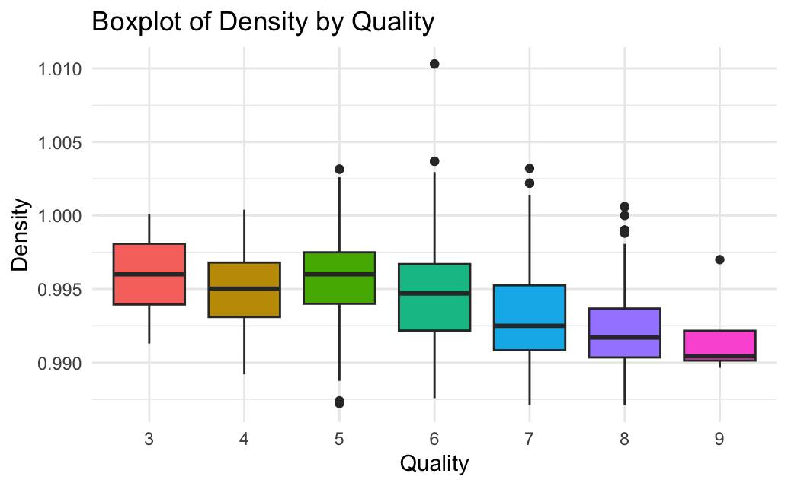
Density vs Quality
Note: Higher levels of quality associated with lower values of density

Slide 7
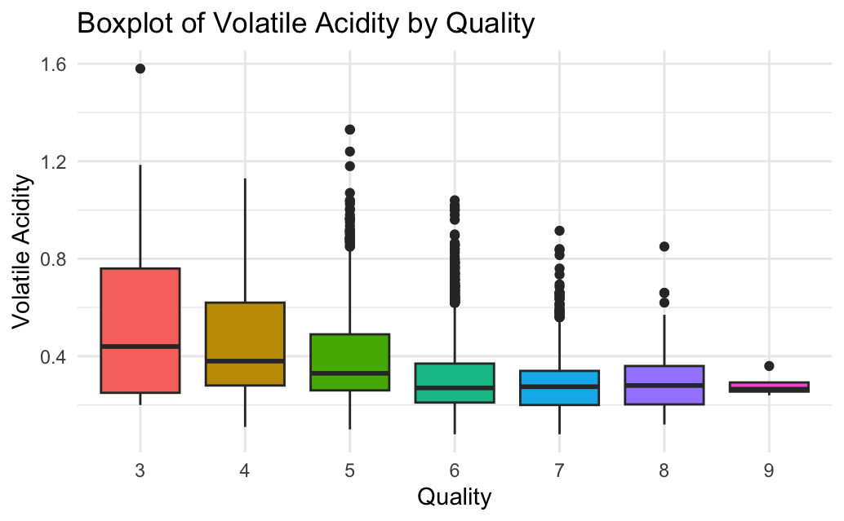
Volatile Acidity vs Quality
Note: Higher levels of quality associated with lower values of volatile acidity

Slide 8
Quantitative Comparison
Variable | Correlation with Quality
ALCOHOL | 0.44
DENSITY | -0.30
VOLATILE ACIDITY | -0.26
CHLORIDES | -0.20
CITRIC ACID | 0.10
Notes:
Ranked based on magnitude of correlation, regardless of negative or positive correlation

Slide 9





TOP FACTORS
ALCOHOL
DENSITY
VOLATILE ACIDITY
CHLORIDES
CITRIC ACID

Slide 10
PREDICTION MODEL
Multiple Linear Regression Model
Ordinal Logistic Regression Model
MEAN ABSOLUTE ERROR (MAE): Metric used for evaluating regression models and determining best model
Notes:
Two models were compared against each other to predict quality.
- The multiple linear regression model predicts continuous outcomes, so it regarded Quality as continuous values
As said in the model’s name it also predicted quality as if quality and its predictors followed a linear trend
Therefore, the estimates in this model represent the change in the dependent variable for a one-unit increase in a predictor variable.
On the other hand, ordinal logistic regression predicts the probability of each category in the ordinal variable.
It does not assume a strict linear relationship between predictors and is modeled using cumulative probabilities.
- Mean Absolute Error (MAE) is a commonly used metric for evaluating regression models. It measures the average magnitude of errors in a set of predictions, without considering their direction.

Slide 11
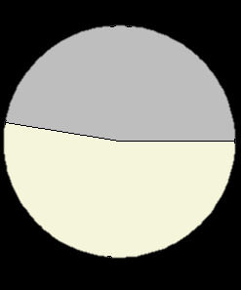

PREDICTION MODEL
Multiple Linear Regression Model
Ordinal Logistic Regression Model
False (47.4%)
False (46.7%)
Correct (52.6%)
Correct (52.3%)
MAE = 0.53
MAE = 0.05
Notes:
Here are the results of each model. As you can see, they appear to have similar accuracies, especially when rounding up the predictions of the multiple linear regression model. However, the distinction is in the MAE. MLR was not the ideal model as the model tended to predict values that may have fallen between two categories, such as 2 and 3.

Slide 12
NEXT STEPS
Monitor Alcohol Content:
Aim for optimal fermentation processes
Control Density:
Ensure appropriate sugar levels during fermentation
Closely monitor the wine’s specific gravity
Manage Volatile Acidity:
Implement stringent quality checks
Affects wine taste and stability
Regulate Chlorides:
Focus on soil and water management techniques
Optimize Citric Acid Levels:
Utilize proper acidification methods to balance the wine’s pH
Notes:
As for next steps, we recommend
Monitor Alcohol Content: Aim for optimal fermentation processes to achieve desired alcohol levels, balancing flavor and aroma.
Control Density: Ensure appropriate sugar levels during fermentation and closely monitor the wine’s specific gravity to maintain ideal density.
Manage Volatile Acidity: Implement stringent quality checks to minimize the presence of volatile acidity, which can affect wine taste and stability.
Regulate Chlorides: Keep chloride levels in check to avoid negative impacts on taste, focusing on soil and water management techniques.
Optimize Citric Acid Levels: Utilize proper acidification methods to balance the wine’s pH, enhancing freshness and stability.

Slide 13
thank you.
want to learn more?
contact us:
Katherine Nguyen – nguyenkh@smu.edu
Isiah Perine – iperine@smu.edu

